Slide 1
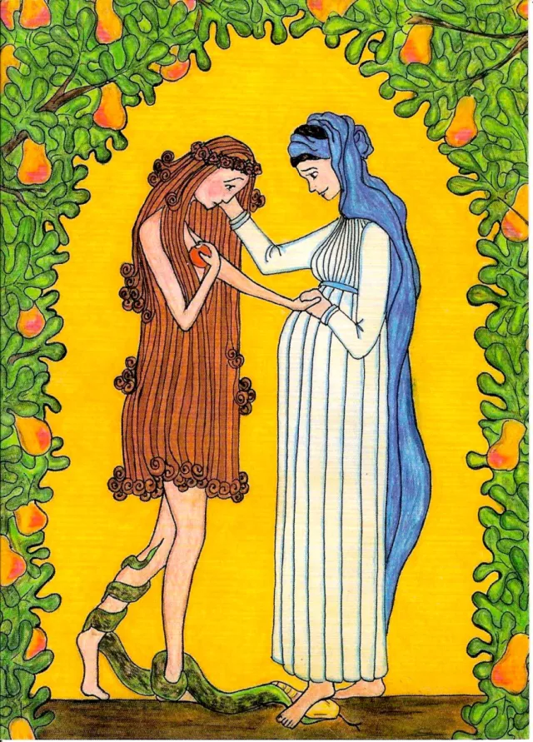
Fall and Redemption
Theology 100
Part 5
Pastor Tim LeCroy

Slide 2
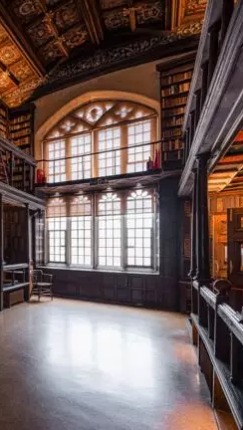
Theo 100 review
Theology is culturally relevant reflection on God and His world
    Anyone who asks questions and thinks deeply about this world is a theologian
    Are we well (in)formed theologians?
  The main source for theology is the Bible
    Other sources can support

Slide 3

Theo 100 review
The universe has a first cause
    Or the Universe is eternal with no cause
    Without a very powerful creator explaining order from chaos and life from non-life is difficult.
We cannot know this first cause without it revealing itself to us
    Due to the necessity of being outside of space/time
The Bible’s claim is that the Bible itself is the revelation of this first causer to us so that we can know him.

Slide 4
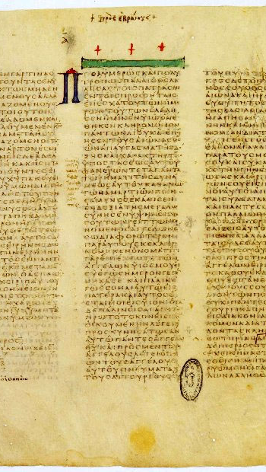
Theo 100 review
The text of the Bible has been reliably transmitted to us from the originals (autographs)
    The Apostles understood that they were writing inspired scripture under Jesus’ authority
    The early church recognized the Spirit breathed Apostolic writings
  The testimony of the early church from the 1st-5th centuries confirms the Bible that you hold in your hand.
    No other texts were ever accepted.
  Your Bibles are translated directly from the Hebrew and Greek texts
    Scholars approximate the original texts through scientific processes called textual criticism

Slide 5
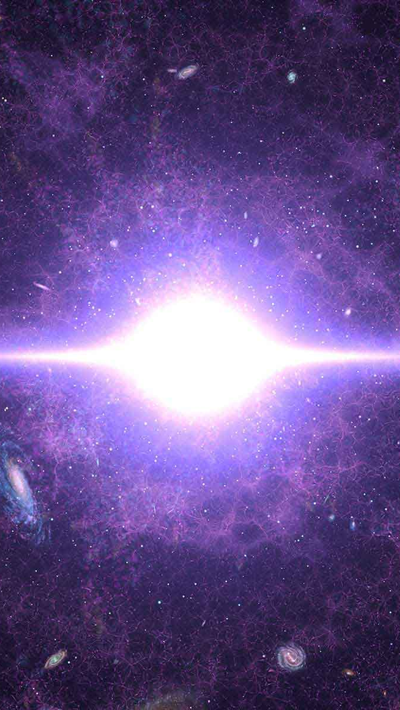
Theo 100 review
The Bible reveals what we are to know about God and his creation.
God is eternal, Triune, omnipotent, omnipresent, and omnibenevolent
God created everything that exists, and his creation is good
We were created to work by studying and utilizing God’s creation, bring him glory, and to enjoy God forever.

Slide 6
Question
If God created everything good, then why is there so much evil, pain, and sorrow in the world?

Slide 7
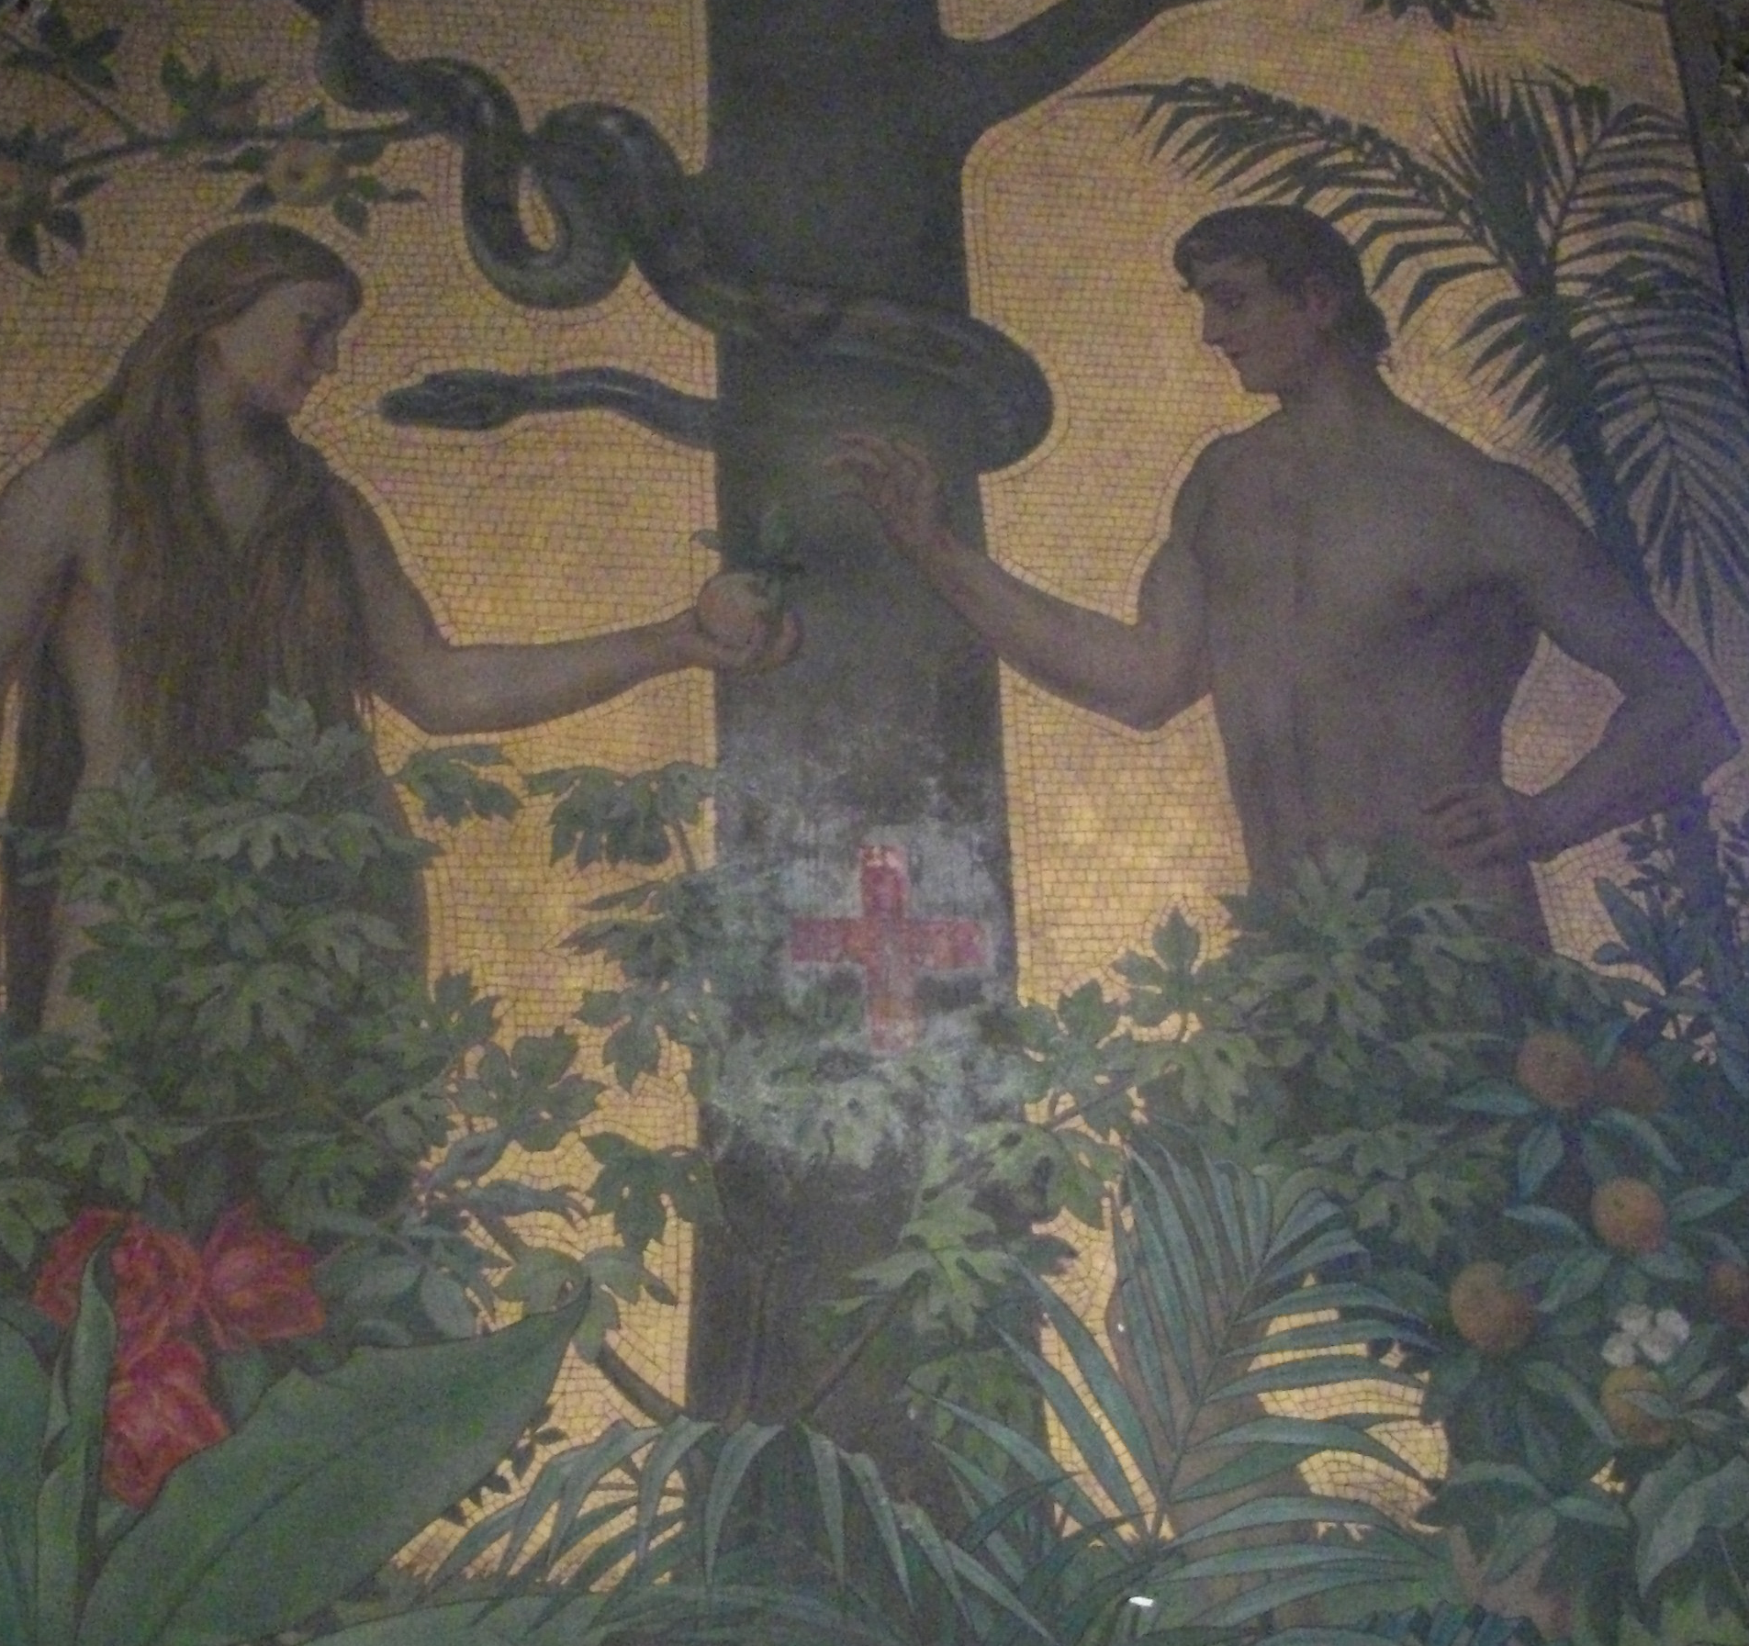
Genesis 3 – the fall
Our first parents, being left to the freedom of their own will, fell from the estate wherein they were created, by sinning against God.
The fall brought mankind into an estate of sin and misery.
All mankind by their fall lost communion with God, are under his wrath and curse, and so made liable to all miseries in this life, to death itself, and to the pains of hell for ever.
-Westminster Shorter Catechism

Slide 8
Genesis 3 – the Temptation
Now the serpent was more crafty than any other beast of the field that the LORD God had made. He said to the woman, "Did God actually say, 'You shall not eat of any tree in the garden'?" 2 And the woman said to the serpent, "We may eat of the fruit of the trees in the garden, 3 but God said, 'You shall not eat of the fruit of the tree that is in the midst of the garden, neither shall you touch it, lest you die.'" 4 But the serpent said to the woman, "You will not surely die. 5 For God knows that when you eat of it your eyes will be opened, and you will be like God, knowing good and evil." 6 So when the woman saw that the tree was good for food, and that it was a delight to the eyes, and that the tree was to be desired to make one wise, she took of its fruit and ate, and she also gave some to her husband who was with her, and he ate. (Gen. 3:1-6)

Slide 9
Genesis 3 – the Trial
Then the eyes of both were opened, and they knew that they were naked. And they sewed fig leaves together and made themselves loincloths. 8 And they heard the sound of the LORD God walking in the garden in the cool of the day, and the man and his wife hid themselves from the presence of the LORD God among the trees of the garden. 9 But the LORD God called to the man and said to him, "Where are you?" 10 And he said, "I heard the sound of you in the garden, and I was afraid, because I was naked, and I hid myself." 11 He said, "Who told you that you were naked? Have you eaten of the tree of which I commanded you not to eat?" 12 The man said, "The woman whom you gave to be with me, she gave me fruit of the tree, and I ate." 13 Then the LORD God said to the woman, "What is this that you have done?" The woman said, "The serpent deceived me, and I ate." (Gen. 3:7-13)

Slide 10
Genesis 3 – the Judgment
To the woman he said, "I will surely multiply your pain in childbearing; in pain you shall bring forth children. Your desire shall be contrary to your husband, but he shall rule over you." 17 And to Adam he said, "Because you have listened to the voice of your wife and have eaten of the tree of which I commanded you, 'You shall not eat of it,' cursed is the ground because of you; in pain you shall eat of it all the days of your life; 18 thorns and thistles it shall bring forth for you; and you shall eat the plants of the field. 19 By the sweat of your face you shall eat bread, till you return to the ground, for out of it you were taken; for you are dust, and to dust you shall return." (Gen. 3:16-19)
Then the LORD God said, "Behold, the man has become like one of us in knowing good and evil. Now, lest he reach out his hand and take also of the tree of life and eat, and live forever-- " 23 therefore the LORD God sent him out from the garden of Eden to work the ground from which he was taken. 24 He drove out the man, and at the east of the garden of Eden he placed the cherubim and a flaming sword that turned every way to guard the way to the tree of life. (Gen. 3:22-24)

Slide 11
The Effects of the fall
Pain (vs. 16, 17)
Relational brokenness (16)
    Generational conflict (16)
    Sexism/misogyny other forms of bigotry (16)
Evil Desire (vs. 16)
    Envy, wrath (Gen 4, 37)
    Pride (Gen 11)
    Lust, Gluttony (Gen 19, 34, 38)
    Greed, Sloth (Gen 25, 29, 31)

Slide 12
The Effects of the fall
Curse of Nature (vs. 17)
    Bodily Corruption
          Diseases
          Disorders
          Limits of mind and body

Slide 13
The Effects of the fall
Curse of Nature (vs. 17)
    Bodily Corruption
          Diseases
          Disorders
          Limits of mind and body
    Natural disasters
          Geologic
          Meteorologic
          Astronomic
          Chemical/Physical

Slide 14
The Effects of the fall
Curse of Nature (vs. 17)
    Bodily Corruption
          Diseases
          Disorders
          Limits of mind and body
    Natural disasters
          Geologic
          Meteorologic
          Astronomic
          Chemical/Physical
    Danger
          Animals
          Exposure to elements
          Natural forces
        The Creation Groans (Rom. 8:22)

Slide 15
The Effects of the fall
Curse on Work (vs. 17-19)
    Pain
    Futility/mix results
    Difficulty
  Death (vs. 19)
  Separation from God and His blessings (vs. 22-24)

Slide 16
The Effects of the fall
Radical Depravity
    The LORD saw that the wickedness of man was great in the earth, and that every intention of the thoughts of his heart was only evil continually. (Gen. 6:5)
  Not the way it’s supposed to be!

Slide 17
And yet, redemption
  Atonement
    “Where are you?” (Gen. 3:9)
    Clothed them with skins (vs. 21)
  Salvation
    I will put enmity between you and the woman, and between your offspring and her offspring; he shall bruise your head, and you shall bruise his heel." (vs. 15)
  Common Grace (vs. 22-24)

Slide 18
Fall and Redemption
Theology 100
Part 5
Pastor Tim LeCroy

